Slide 1
Patent Equity
MIT Collaboration Data Analysis
Sponsor: Professor Jordi Goodman
Data Collection: Yuxin Liang, Zihua Xin, Wanyi Chen
Data Analysis: Weirun Huang, Jiarui Fu

Slide 2
Project Goal
To investigate gender disparity in patents, articles and conference proceedings and how the disparity has changed over time
To determine if newer faculty members are experiencing the same disparity as older faculty members
Notes:
Whether gender disparity exists in patents, articles and conference proceedings for faculty members in MIT and how the disparity has changed over time

Slide 3
Data Collection
Scraped information for 1401 faculty members from the MIT collaboration website
Names, departments and work years of the faculty members
Publishing dates for articles and conference proceedings
USPTO numbers for patents
Filing dates for ~4000 patents from USPTO database
Gender Classification:
Used an online tool, gender-api (based on first names)
Validation accuracy of 0.90
Challenges:
Limitations in API
Notes:
The API that the website uses does not have any documentations. So lots of testing.
Only returns 100 entries per query, which limits the size of our dataset. Employ techniques to get around limitation and maximize our dataset

Slide 4
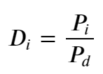
Data Analyses
Performed Student’s T-test/Welch’s T-test between the average number of publications for male and female faculty members
Calculated Disparity Index for male and female faculty members at a given year
Applied linear regressions for Disparity Index
Performed Student’s T-test/Welch’s T-test between the two genders for older and newer faculty members.
Notes:
To show if there is a Statistically significant disparity by gender in patents, articles, and conference proceedings
Percentage of publications for each gender
Percentage of faculty members for each gender
Disparity Index close to one means the genders are equally represented
We used disparity index to investigate how gender disparity has changed over time
Applied linear regressions to quantify trends in gender disparity
Newer faculty members are experiencing similar gender gaps to older faculty members

Slide 5
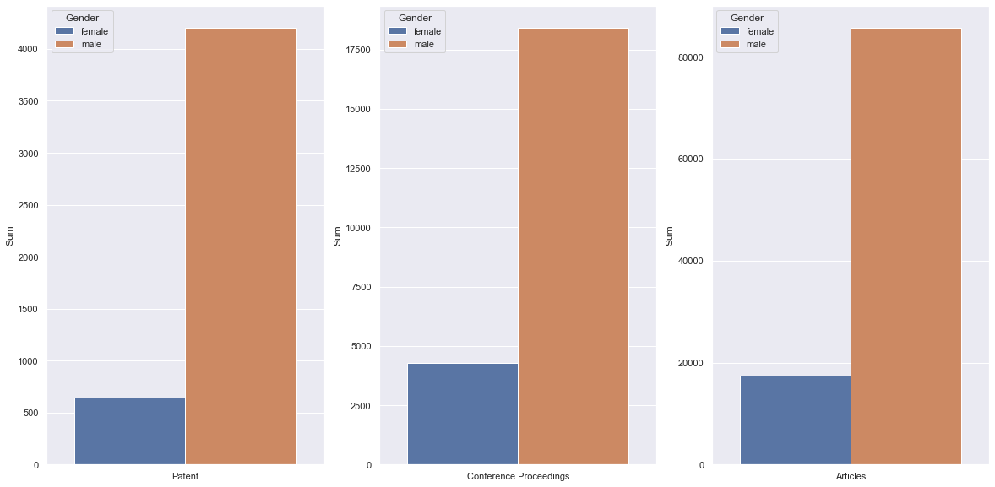
Visualizations
Notes:
Histograms shows the total number of publications for each of the gender
Clearly see a large gender disparity across the board
After running t-tests using an alpha 0.05,
We found statistically significant gender disparity in average article count (point)
For other types of publications, not enough evidence to reject null, likely due to high variance

Slide 6
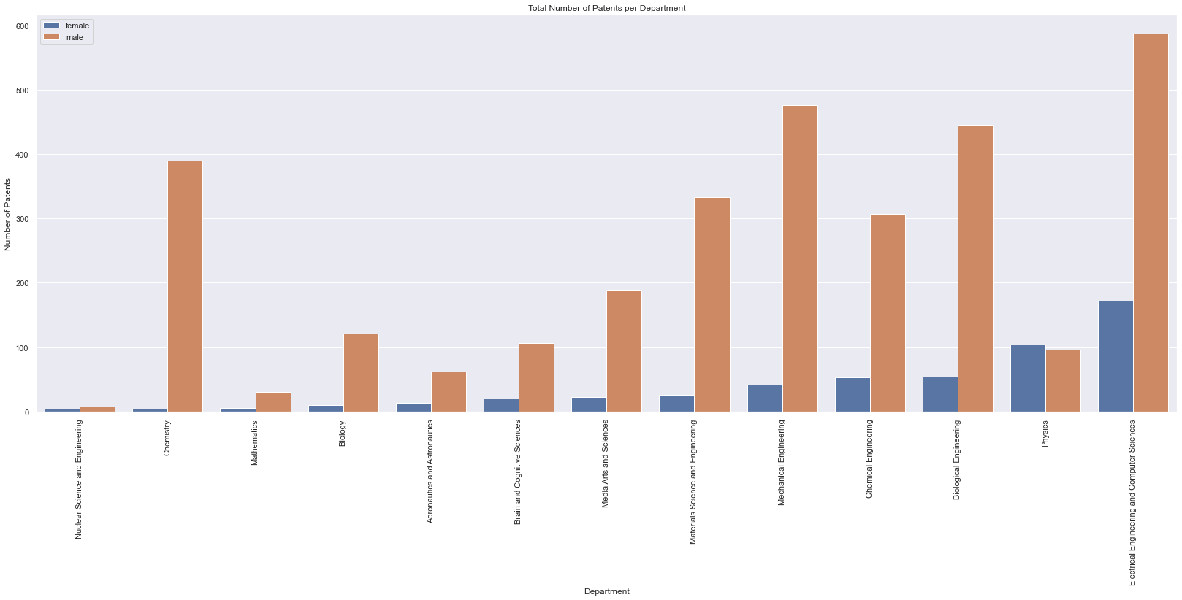
Visualizations
Notes:
Moving on, we want to examine if the gender disparity exists for all of the departments
Here we only present patents for the sake of time
If you take a look at this graph, Plot total number of patents for each of the departments
Similarly, large gender disparity across the board, except (Physics), same faculty members
Running t-tests, we found statistically significant gender gaps in Biology, Material Science

Slide 7
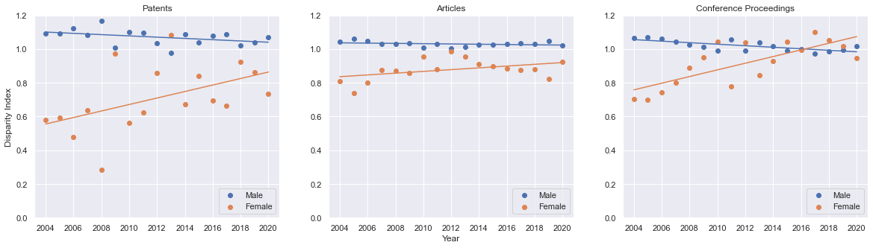
Visualizations
Notes:
Then we want to answer: has the gender disparity changed over time?
Plot disparity index for male and female faculty members
Reminder disparity index close to one is equally represented
Attention on patents and conference proceedings, both gender trending towards one => gender disparity has been improving over time
After applying linear regression, we found statistical significance for trends in patents and conference proceedings

Slide 8
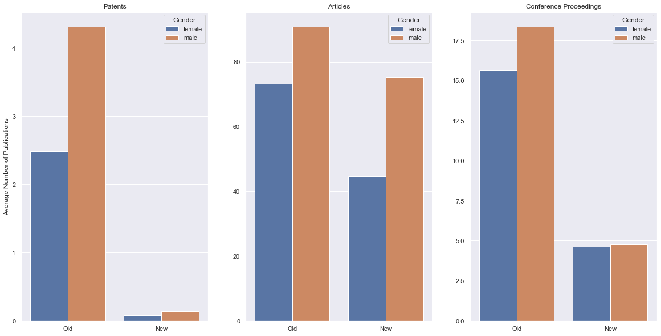
Visualizations
Notes:
Histograms showing the total number of publications for older and newer faculty members to see if newer faculty members subjected to similar gender gaps as older faculty members
Only found statistical significance for older faculty members in article counts

Slide 9
Conclusion
Conclusions:
Statistically significant gender disparity in mean article counts overall in MIT and for older faculty members
Gender disparity improving over the time period for patents and conference proceedings
Possible Next Steps
Additional work can be done in terms of race disparity instead of only gender disparity
Too few black and hispanic faculty members
Name-based race predictions can be highly unreliable
Notes:
Sample size too limited for showing statistical significance.
Predicting race based on first names and last names is highly unreliable.

Slide 10
Thank You

